Slide 2
INTRODUCTION TO RECORDS AND INFORMATION MANAGEMENT
Information for public officials
RTI Officers Training Day 3

Slide 3
CAPACITY CHECKLIST
Is my organisation managing records well?
Ten questions with yes or no answers

Slide 4
LEARNING OBJECTIVES
At the end of this presentation, you will be able to:
Define records
Understand the Vision and Mission of the national policy on records and information management
Understand the provisions in the national policy on records and information management
Understand the different responsibilities in the national policy on records and information management
Understand the objectives and activities in the national policy on records and information management
Understand the requirements of the Code of practice on records and information management

Slide 5
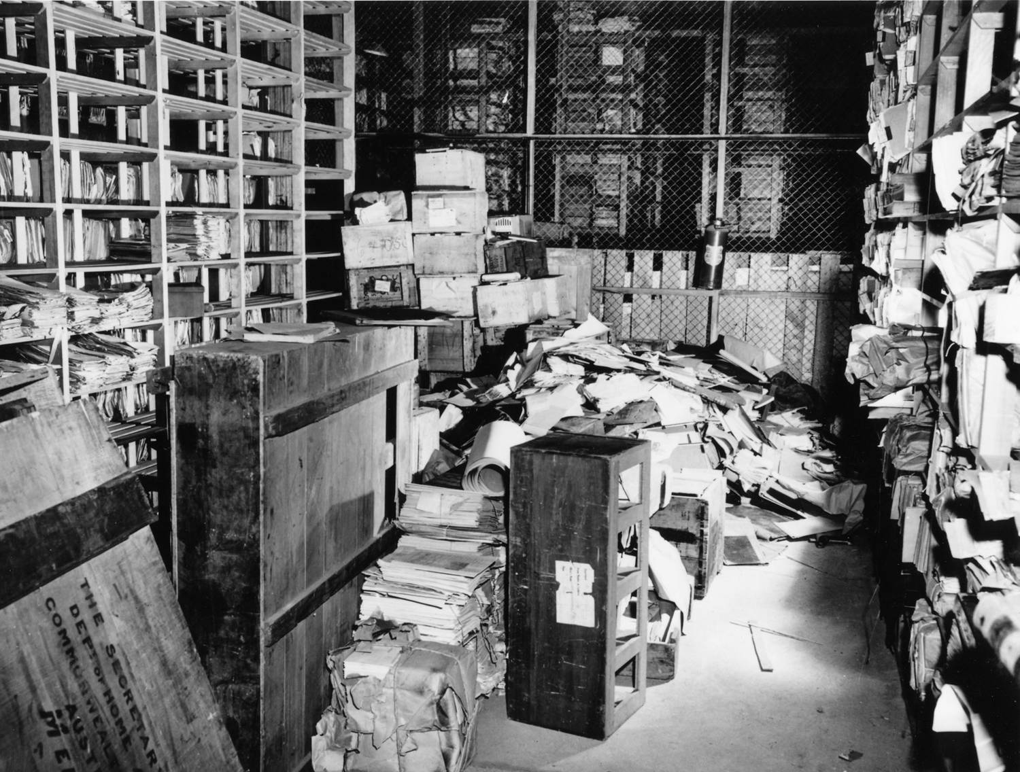

Slide 6
WHAT IS A RECORD?
Record means information held in any form or medium by a Government agency, relevant private entity, whether or not it was created by any of them or came into existence before the commencement of the Right To Information Act, and includes;
(a) a record in writing; or
(b) a document, manuscript and file; or
(c) a film (including microfilm), negative, microfiche and facsimile copy of a document; or
(d) a map, plan, graph or drawing; or
(e) a photograph; or
(f) a disc, tape, sound track or other device in which sounds or other data are embodied, whether electronically or otherwise, so as to be capable (with or without the aid of some other equipment) of being reproduced; or
(g) an email, memo, opinion, advice, press releases, circular, order, logbook, contract, report, samples and models;

Slide 7
RECORDS MANAGEMENT CYCLE
Life Cycle of Records
Creation & receipts of records
Use & dissemination
Maintenance & storage
disposition of records
Archives & access

Slide 8
National Policy on Records and Information Management
VISION
MISSION
It is our vision that Vanuatu Government public records, the cornerstone of government transparency and a knowledgeable and informed populace, are recognized and managed as public assets.
It is the mission of the Government of Vanuatu to provide, protect, promote, and preserve Government public records, in collaboration with relevant public authorities , for the benefit of the people of the Republic of Vanuatu.

Slide 9
NATIONAL POLICY PROVISIONS
Records must be made
Records must be accurate
Records must be authentic
Records must be integrity
Records must be accessible and useable
Records must be disposed of appropriately

Slide 10
WHAT ARE OUR RESPONSIBILITIES IN RECORDS MANAGEMENT?

Slide 11
RECORDS OFFICER /FILING CLERK
They must:
Comply with this policy and follow any procedures for records management issued by respective government agencies;
Plan for appropriate accommodation for records;
Train all members of staff on relevant records keeping systems;
Initiate the disposal of records in line with agencies;
Carry out records survey and appraisal;
Prepare records retention and disposal schedules;
Provide advice to other staff on records management that is consistent with this policy.

Slide 12
ALL PUBLIC SERVICE OFFICIALS
comply with this policy and with any recordkeeping procedures issued by the organisation;
ensure that they make and file records of all official actions and decisions they take as government officers
handle records with care so that they are not lost, damaged or destroyed;
prevent unauthorised access to government records; and
ensure that they do not alter, destroy, misplace or render unusable any official document, record or file that is intended to be maintained as official records without the authorisation of the national archivist and the senior officer who has been assigned responsibility for records management.

Slide 13
Archivist, National Archives of Vanuatu
The Archivist of the National Archives of Vanuatu shall:
implement the provisions of Archives Act [CAP 216];
develop and review policies, systems, and guidelines for the management of public records;
advice on the development of training curriculum on records management in consultation with VIPAM and other training institutions;
guide public officers in the implementation of this policy;
forge partnerships with public institutions whose Acts of Parliament or regulations bear instructions on management of records;
conduct regular surveys on records management activities in public offices;
consult with senior corporate managers to determine which records can be responsibly destroyed and which must be retained as part of the archival resources of the nation;
accept transfers of records that have been assessed as being of archival value so that they can be preserved for future generations; and
assist the government with the monitoring and review of this policy.

Slide 14
Right to Information Unit
The Right to Information Unit after consulting all relevant and interested parties, and on the recommendation of the Archivist appointed under section 5 of the Archives Act [CAP 2016], issue a Code Practice relating to:
the creation, keeping, management and disposal of records; and
the transfer of records to the National Archives.

Slide 15
Objectives and Plan of Action

Slide 16
Access
Objectives
To ensure timely access to records and information
To ensure easy access to records and information
Activities
Create a Records Management position in your agency to coordinate records and information management initiatives in the government agency.
Establish annual awareness and training for government Records Management Officers and all other government officers.
Make provisions for all government agencies to have access to relevant technology for easy access to information.
Develop an administrative record plan for each agency.

Slide 17
Security
Objectives
To ensure records are stored securely and protected from unauthorised access, alteration, deletion or loss
Ensure access controls are changed when employees leave their positions
Ensure information is protected from “leaking” (i.e. prevent files from leaving building through mechanical / electronic means; ensure sensitive electronic information cannot be emailed, downloaded, posted or otherwise made available electronically) – clearly identify such safeguards in policy
Activities
Develop and implement a RIM security policy
Develop and implement a vital records program

Slide 18
Legal and regulatory framework
Objectives
To ensure all government agencies, relevant private entities and private entities are fully aware of legislations, policies and standards available in relation to records and information management.
To ensure government agencies, relevant private entities and private entities can develop their internal policy and procedures on records and information management.
To ensure Vanuatu has a Code of Practice on Records and Information Management
Activities
Government agencies, relevant private entities and private entities must develop their own records and information management policy and procedures which must be approved by the senior management.
Conduct awareness and training sessions with government agencies, relevant private entities and private entities on records and information management framework available.
Publish Code of Practice on Records and Information Management.

Slide 19
DISPOSAL, DELETION OR TRANSFER OF RECORDS
Objectives
To ensure all government agencies, relevant private entities and private entities understand their responsibility under the Archives Act
To ensure both physical and digital records are disposed of in line with authorised procedures
If records are converted or migrated to new media, disposition of the previous media may also be warranted.
Disposition of relevant records must be suspended in the event of pending or ongoing litigation or audit. The organization should designate records that are to be held pending resolution of the litigation or audit and notify all affected personnel when the hold is issued and when the hold is released.
Destruction of records must be performed in a secure manner, ensuring that records to be destroyed are transported securely and destroyed completely. The organization may choose to utilize “green” methods of destruction, but destruction must always be performed in a manner that renders the records completely and irreversibly destroyed.
The transfer of records to the custody of a historical archives, library, or museum should be documented as part of the organization’s records retention policy.
Disposition of records must be government by appraisal of the records by qualified professional upon the basis of the historical or intrinsic value of records.
Activities
Conduct training and awareness sessions on the Archives Act provisions
Ensure sufficient space is available for the National Archives to house all relevant /historical/government records.
Government agencies, relevant private entities and private entities should develop their disposal schedules to assist in the disposal process.

Slide 20
IMPLEMENTATION
Objectives
To provide a structure that facilitates the application of this policy, provide for an effective government program that raises awareness and training to public officials, and engage government agencies, relevant private entities and private entities in implementing this policy.
Activities
Formulate appointment of NRIMDC
Develop and gauge the progress of implementation of this policy by government agencies, relevant private entities and private entities
Identify and execute innovative methods of engagement with government agencies in outlying provinces;
Develop educational materials on RIM for government officials; and
Develop and execute government RIM educational activities using a wide range of communication means and networks and which are suited to the Vanuatu geographical and socio-economic contexts.

Slide 21
MONITORING AND EVALUATION
Objectives
To ensure this policy is regularly monitored and reviewed;
To review and evaluate the overall progress of implementation activities under this policy;
To review and evaluate the performance of policy bodies in the discharge of their RIM obligations;
To distil best practices and promote their replication;
To identify areas for improvement; and
To make recommendations for review and reform.
Activities
The NRIMDC will have overarching oversight of the National RIM policy implementation activities, with multiagency membership of representatives comprising of government officials with records management experience and background.
Establish reporting systems
Establish monitoring systems, whether paper or computer based to evaluate the effectiveness of their RIM systems;
Information collected on evaluation of RIM systems is published in their reports and presented to the Information Commissioner;
The Information Commissioner receives monthly report from government agencies, relevant private entities and private entities using report template provided by the Information Commissioner
Information Commissioner will produce an annual report which will include matters such as an analysis of each public body’s implementation of the National RIM policy.

Slide 22
PROFESSIONAL DEVELOPMENT
Objectives
To ensure that the government agencies, relevant private entities and private entities have a records management officer appointed. The records management officials are appropriately trained and provided with professional development opportunities in the National RIM policy including proper Records Management procedures, proper incentives are in place.
Activities
Development of RIM training module
Ensure that RIM training is provided by VIPAM
Develop a “Training of trainers” activity to enable RIM officers to conduct training in their own organisations as required
Completion of RIM training established as a performance indicator for public officers
National Archives, RTI Unit and other regional/international bodies provide training and refresher courses on Records and Information Management

Slide 23
INFRASTRUCTURE
Objectives
Development of a National Document Management system to organise and keep government records
Digitising of government records
Storage and dissemination of government records through electronic formats
Security of electronic records created and stored by government agencies
Activities
The National “ICT for All” policy, and the implementation activities to be carried out in line with an electronic records formation, security and validity of government electronic records
Implementation of the ICT policy, including provision of access to training and human resource development for RIM officers
ICT policy and its implementation reviewed periodically to ensure that government agencies, relevant private entities and private entities have adequate access to ICT facilities.

Slide 24
RESOURCES
Objectives
To enable the success of the RIM regime by ensuring that implementation activities are adequately resourced and adequate financial and human resources are provided by the government and to seek the support of development partners where extra budgetary assistance, in these respects, is required.
Activities
Ensure funding support for government agencies to appoint RIM officers
The provision of financial support for training activities of RIM officers and other relevant public officers
Ensure the provision of financial support for the development of government RIM educational materials and activities

Slide 25
AUTHORITY
The National Records and Information Management Policy has been approved by the Council of Ministers on Friday 25th May 2018.

Slide 26
THANK YOU FOR YOUR PATIENCE! Any questions?

Slide 27
Coffee Break!!

Slide 28
CODE OF PRACTICE ON RECORDS AND INFORMATION MANAGEMENT
Information for public officials

Slide 29
CREATION OF RECORDS
Government agencies must document their activities
Records of activities should be complete and accurate
Records created should be arranged in a record keeping system that will enable the organisation to obtain maximum benefit from the quick and easy retrival of information

Slide 30
FILING SYSTEMS
A recordkeeping system is a tool to manage records.
A record keeping system should have the following characteristics:
Reliability
Integrity
Compliance
Comprehensiveness
Systematic

Slide 31
Storage and maintenance
Know what records your agency holds and where they are.
Decide which format to store electronic records and manual records.
Special care and monitoring is recommended in the case of vulnerable and sensitive material and paper files.
Consider keeping back up copies.
All information held by the government is treated the same for purposes of RTI.

Slide 32
Security and access
Government agencies and relevant private entities should have an information security policy in place to comply with Code of practice on records and information management
Restrict access where necessary especially to personal data or confidential information.
Keep record of who has accessed the records and when records have been transferred to another location to enable access to the records.

Slide 33
Management of records
All government agencies and relevant private entities note the National Records and Information Management Plan and their responsibilities as outlined in the National Policy.

Slide 34
Monitoring and evaluation
Undertake compliance monitoring to ensure that the records management processes and controls are being implemented
Consider arrangements to deal with loss or unauthorized destruction of records.
Progress on records management activities should be provided in the RTI Officers report to the RTI Unit on a monthly basis.

Slide 35
Records management training
Regular training of government officials on records management requirements and practices
Records officers must receive training on records management concepts, principles and practices
Records management training should be provided to staff at the appropriate timing to facilitate their work.

Slide 36
Disposal of records
Government agencies and relevant private entities should define how long they need to keep particular records, should dispose of them when they are no longer needed and should be able to explain why records are no longer held.

Slide 37
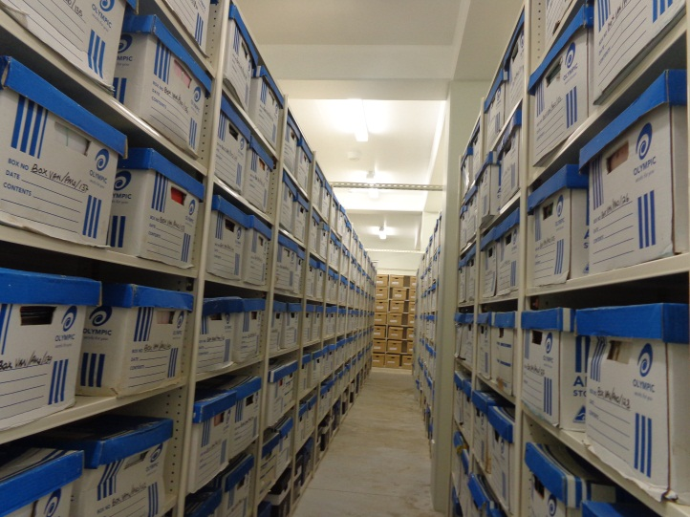
What is disposal?
The decision as to whether the record should be destroyed or transferred to the National Archives.

Slide 38
General principle
Records should be kept as long as they are needed by the government agency or relevant private entity
Do not keep records after they have ceased to be of use to the government agency or relevant private entity unless:
It has outstanding litigation purposes
Long term historical value to the agency
Contains information recently released in response to a request under RTI.

Slide 39
Public archives not to be disposed of without authority of the archivist
No person shall dispose of, or authorize the destruction or other disposal of any public archives without the consent of the Archivist.

Slide 40
Destruction of Routine Public Archives
The Archivist may authorize the immediate destruction, or the destruction after the expiration of such specified time as may be agreed upon between the Archivist and the head of the Government office concerned, of any specified classes of public archives that -
By reason of their number, kind or routine nature do not in his opinion possess any enduring value for preservation in the National Archives as public archives; and
Are not required for reference purposes in any Government office after action on them is completed, or
after the expiration of such period of years from the date on which action on them is completed as may
be agreed upon between the Archivist and the head of the Government concerned.

Slide 41
DOCUMENTING THE DESTRUCTION OF RECORDS
Details of destruction of records should be kept
It should be possible to provide evidence that a records has been destroyed as part of routine records management processes destruction

Slide 42
TRANSFER OF RECORDS TO NATIONAL ARCHIVES
Public archives of Vanuatu which are considered worth permanent preservation shall be deposited and preserved in the National Archives.

Slide 43
DEPOSIT OF PUBLIC ARCHIVES TO THE NATIONAL ARCHIVES OF VANUATU
All public records of the age of fifteen years or over (other than those which are under any Act are required to be held in the custody of a specified person or Government office) which in the opinion of the Archivist are of sufficient value to warrant their preservation as –
Evidence of the organisation, functions and transactions of the Government office in which they were originally made or received; or
Evidence of public or private personal or property rights or civic rights; or
Containing historical or general information.
Shall be transferred to the custody of the Archivist and be deposited in the National Archives.

Slide 44
DEPOSIT OF PUBLIC ARCHIVES LESS THAN FIFTEEN YEARS OF AGE
The Archivist may allow the deposit in the National Archives of public archives of less than fifteen years of age if he considers that they are of sufficient value for deposit.
Any deposit of public archives may be subject to any special conditions imposed by the head of the Government office making the deposit.

Slide 45
PUBLIC RECORDS & ARCHIVES NOT IN THE NATIONAL ARCHIVES
The Archivist may from time to time inspect, any public records or public archives that are for the time being in the possession or under the control of any Government office and give instructions as to their safe preservation and such advice as to their efficient and economical administration and management as he considers necessary.

Slide 46
RETURN OF PUBLIC ARCHIVES TO GOVERNMENT OFFICE
Where the head of the Government office by which any public archives was deposited in the National Archives or head of the successor of that Government office, satisfied the Archivist that the public archives is required for use in that Government office, the Archivist shall return the public archives to the custody of that Government office for such period as may be agreed upon between the Archivist and head of the Government office, and subject to such conditions as the Archivist may impose to ensure the safe custody and preservation of that public archives during the time it is kept in the Government office.

Slide 47
PUBLIC RECORDS & ARCHIVES TO BE SURRENDERED ON DEMAND
Where any public archives or public record (being an archives or a record that is the property of the Government) is in the custody or possession of any person, other than a Government office, a public officer or other person authorized to have such custody or possession in his official capacity, and the original of that public archives or public record is not in the possession of any Government office or deposited in the National Archives, that person shall, on demand in writing by the Archivist, deposit that public archives or public record in the National Archives.

Slide 48
PUBLICATION OF PUBLIC ARCHIVES
On the recommendation of the Archivist, the Minister responsible for Archives may authorize the publication of any public archives deposited in the National Archives and available for public reference which he considered to be of sufficient interest to warrant their publication.

Slide 49
Copyright
Nothing in this Code shall derogate from any provision of the law relating to copyright in relation to anything contained in any public archives deposited in the National Archives under the provisions of the Archives Act.
Where any person publishes any work containing any passage from any public archives deposited in the National Archives, he or she shall in that publication acknowledge the source from which that passage is taken.

Slide 50
Access after transfer of public records
All archives deposited in the National Archives shall be available for public reference.
No actions described in the Code of Practice affects the statutory right of access to information established under the RTI Act.
When an information ceases to be exempt under RTI the records will become automatically available to members of the public.
If an agency wishes to extend the exempt period, it may do so according to section 51 of the RTI Act.

Slide 51
Question time!!
Please feel free to ask any questions!

Slide 52
LUNCH!!!

