Slide 2
PROACTIVE PUBLICATION
Proactive publication involves publishing information about an issue or a story to prevent having to react to negative public opinion.
Be the first to inform the public

Slide 3
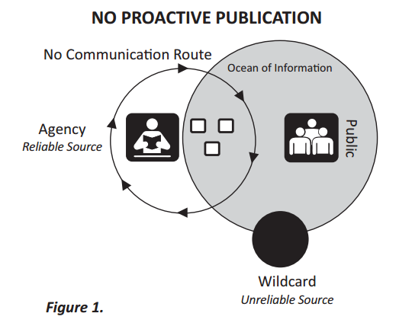
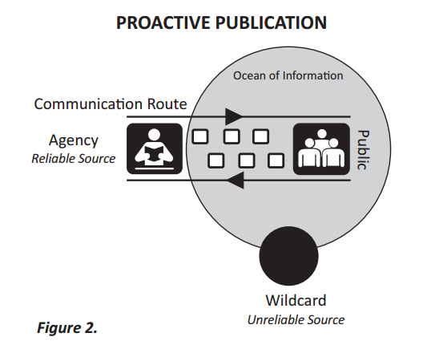
PROACTIVE PUBLICATION

Slide 4
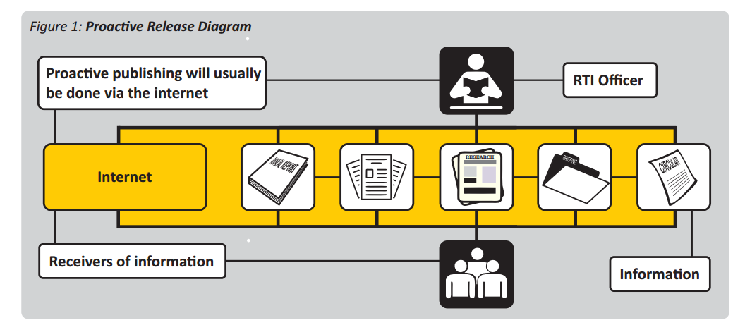
USING THE INTERNET TO PUBLISH

Slide 5
WHY THE INTERNET?
98.8% ACCESSIBILITY
Due to successful expansion roll out and affordable smart phones.
TRBR expected a cross over from mobile calls to mobile data as the go-to option in the last quarter of 2018.
The overall trend is seen to be declining – sms, mobile calls.
GROWING USER NUMBERS
In 2016 around 101,438 mobile internet subscribers, a year later in 2017 the number increased to 125,366.
45%
In 2017 45% of the
population were
internet users.

Slide 6
15 CATEGORIES OF INFO & PROACTIVE PUBLICATION
PART 2, DIVISION 1
There are 15 categories of information. They must be published and disseminated in each official language.
Such other information deemed necessary in the public interest or as may be prescribed by this Act or any other Act
Part 2, Division 1 (o)
‘PROACTIVE PUBLICATION’ ARTICLE
There is one article that encourages proactive publication – the disclosure of information to the public domain on a regular basis.

Slide 7
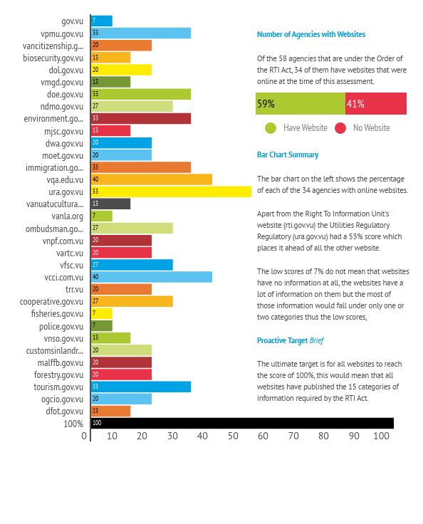

Slide 8
Agency’s Overall Website Progress

Slide 9
WHERE ARE WE IN PROACTIVE PUBLICATION?
2014 NATIONAL INTEGRITY SURVEY
There are significant gaps in information about the public sector
Research Report by Transparency Vanuatu
In the absence of freedom of information laws the extent to which public sector agencies will disclose information held on citizens depends entirely on goodwill relationships.
(Pg. 77)
25% VERY WEAK
There was a very weak practice of the proactive publication of information to the public domain.

Slide 10
SUSTAINABILITY
WHAT TO PUBLISH
News, announcements, tenders, financial news, activities, activity progress, granted RTI applications and failures.
It is better and smarter to be proactive than to have to react to a situation.
WHERE TO PUBLISH?
Radio, TV, newspaper and social media.
Schedule a monthly Public Conference Event & GO LIVE!

Slide 11
LANGUAGE LEVELS
The target recipients of published information may be categorised as being in the intermediate level
of the English, French and Bislama language.
The intermediate level includes everybody regardless of their literacy and language comprehension level

Slide 12
#hashtag
WHAT IS IT?
A hashtag is a type of tag used on social networks to makes it possible for others to easily find messages with a specific theme or content.
#raetblongsave
Agencies can proactively create posts and tag them appropriately so that the public can easily find them.

Slide 13
In-House Training & Support
If you need assistance do not hesitate to contact the Right To Information Unit.
hkevin@vanuatu.gov.vu

Slide 14
TANK YU

